Slide 1


Heart Disease Prediction using Machine Learning
Leveraging clinical data for early detection of heart disease. This project aims to improve patient outcomes via AI-driven insights.
by Seif Aly

Slide 2
Problem Statement & Dataset Overview
Problem
Data Description
Heart disease is a leading global cause of death.
Source: UCI Heart Disease Dataset
Goal: Predict disease early for intervention.
303 records, 14 clinical attributes
Machine learning enhances diagnosis accuracy.
Key features include age, chest pain, cholesterol
Target: 1 = Disease, 0 = No disease

Slide 3
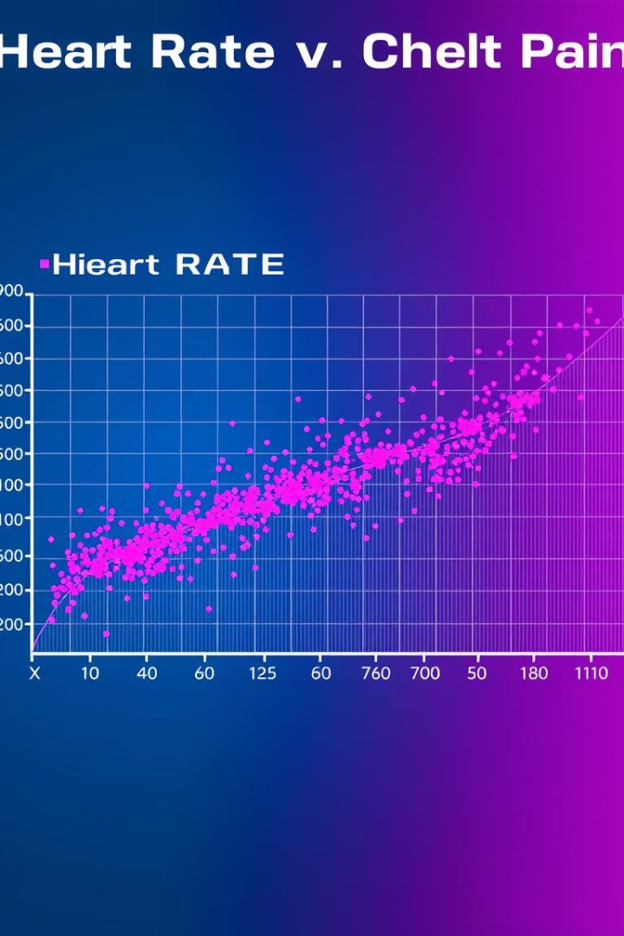
Exploratory Data Analysis (EDA) Highlights
Class Imbalance
Gender Factor
~55% of patients have heart disease.
Males exhibit higher disease prevalence.
Key Predictors
Lower max heart rate and higher ST depression linked to disease.
Chest pain type strongly predicts outcomes.

Slide 4
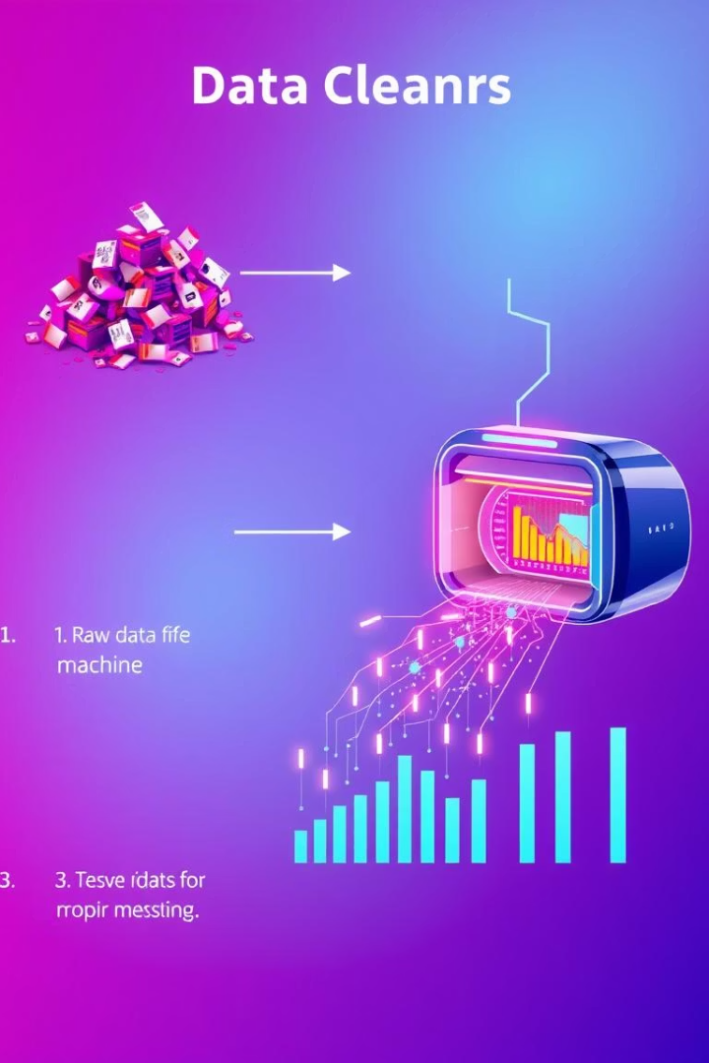
Data Cleaning and Preparation Process
Missing Value Handling
Applied mean imputation for absent data points.
Feature Encoding
Categorical variables transformed for model compatibility.
Scaling Numerical Features
StandardScaler applied for normalization.
Data Splitting
80% training, 20% testing to validate model.

Slide 5
Key Questions & Insights from Data
Distribution
Gender Relation
Heart Rate Influence
~55% positive for heart disease in dataset.
Males have higher risk than females.
Lower maximum heart rate correlates with increased risk.

Slide 6

Model Experimentation Overview
Tested Models
Logistic Regression
K-Nearest Neighbors (KNN)
Decision Tree
Random Forest
Support Vector Machine (SVM)
XGBoost
Evaluation Metrics
Accuracy
Precision
Recall
F1-Score
Confusion Matrix

Slide 7
Comparison of Model Performance
Baseline Model
Highest Performance
Logistic Regression accuracy: ~84%
XGBoost achieved ~90% accuracy.
Robustness and predictive power superior.

Slide 8

Final Model: XGBoost Details
Why XGBoost?
Performance
Handles complex nonlinear data patterns effectively.
Top accuracy and recall metrics among models tested.
Scalability
Efficient training and inference on medium-sized clinical data.

Slide 9
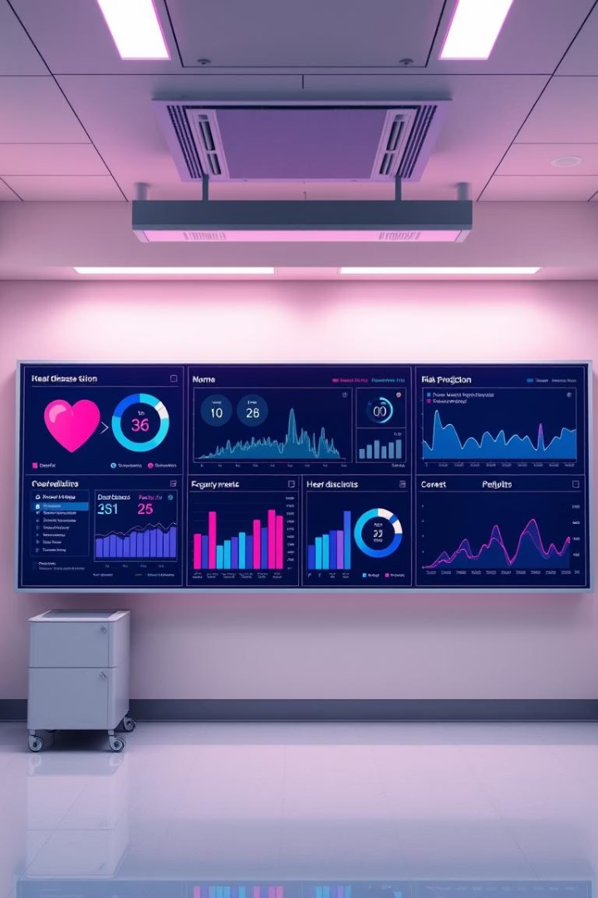




Business Relevance & Integration
Early Diagnosis
Supports clinicians in timely heart disease detection, enabling faster intervention and improved patient outcomes.
System Integration
Can seamlessly embed into hospital electronic health records, streamlining workflow and reducing manual data entry errors.
Patient Prioritization
Identifies high-risk patients for focused screening, optimizing resource allocation and personalized care plans.
Continuous Improvement
Allows ongoing model updates from new clinical data, ensuring accuracy and relevance over time.

Slide 10

Key Takeaways & Next Steps
Insights
Models
Clinical data can robustly predict heart disease.
XGBoost offers the best predictive accuracy.
Next Steps
Deploy in clinical environments, validate with external datasets.

